Slide 1

Epoch Dream Center
By: Julia See, Gina Postorino, Andrew Barbieri, Ryland Bunnell

Slide 2

Who We Are?
Nonprofit Organization pursuing to create nurturing relationships that empower, mentor and encourage students in areas of academics, character development, and social-emotional wellness
Epoch’s staff, mentors and volunteers providing a fun, loving and structured environment so children can excel to their fullest potential
  With student's attendance, this teaches them the value of hard work and the importance of making wise decisions
An established focus on knowing the kids and families, more than just caring and providing for children

Slide 3

What is Epoch?
After school program
  Primary Area: Hebron/ Salisbury
Kids in Grades K-12
  Students that start young typically stay until 12th grade
  Able to stay until 6:30
No cost to students or their families
  Dependent on private funding
Students not only get cared for, but are known and build meaningful connections
  There's a family style dinner every night to get to know the parents as well
Students get homework help, a mentor and to be a kid; to play

Slide 4
Where Do We Get Our Funds From?
Dependent on private funding
Funders
Fundraising is private donation
Grant funding
Various founding with organizations
Henson Center, Henson Foundation
Perdue School of Business
Community Foundation of the eastern Shore
Faithful group of monthly supporters, who give on monthly basis

Slide 5

Who Are Our Stakeholders?
Students
  Why were here and what were doing
Families
Teachers
  In the school systems that work with the students
    Have contact with students every day
Epoch’s board members
  Governing board that guides them
  501c3
  Managerial
Community members
  People around the county, who see what is going on
County of Wicomico
  Being that the council has approved a grant to state
Law enforcement; subset of stakeholders

Slide 6
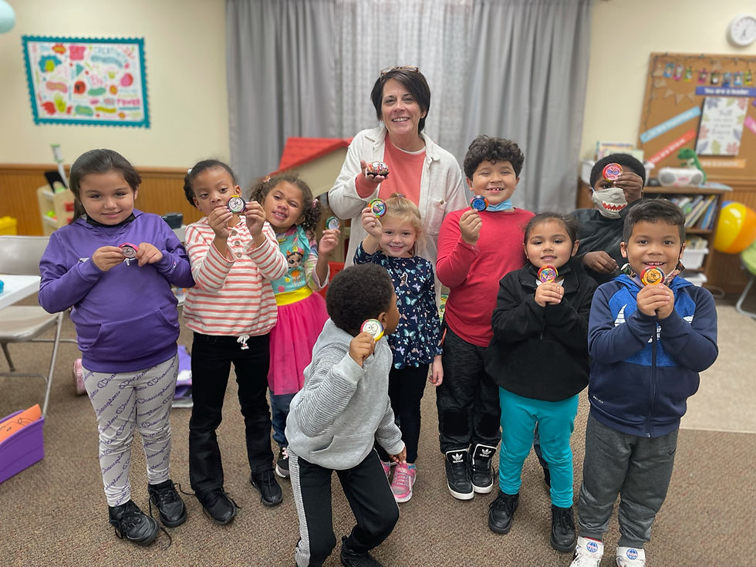
Why Epoch Started
Most of the children in Epoch have challenging home life’s
  Children being abused by parents
  Parents being incarcerated
  Students are getting no sleep
  Students left hungry, with no food
  Last year Epoch provided 1500 meals to students
  Students can build friendships and find mentors

Slide 7
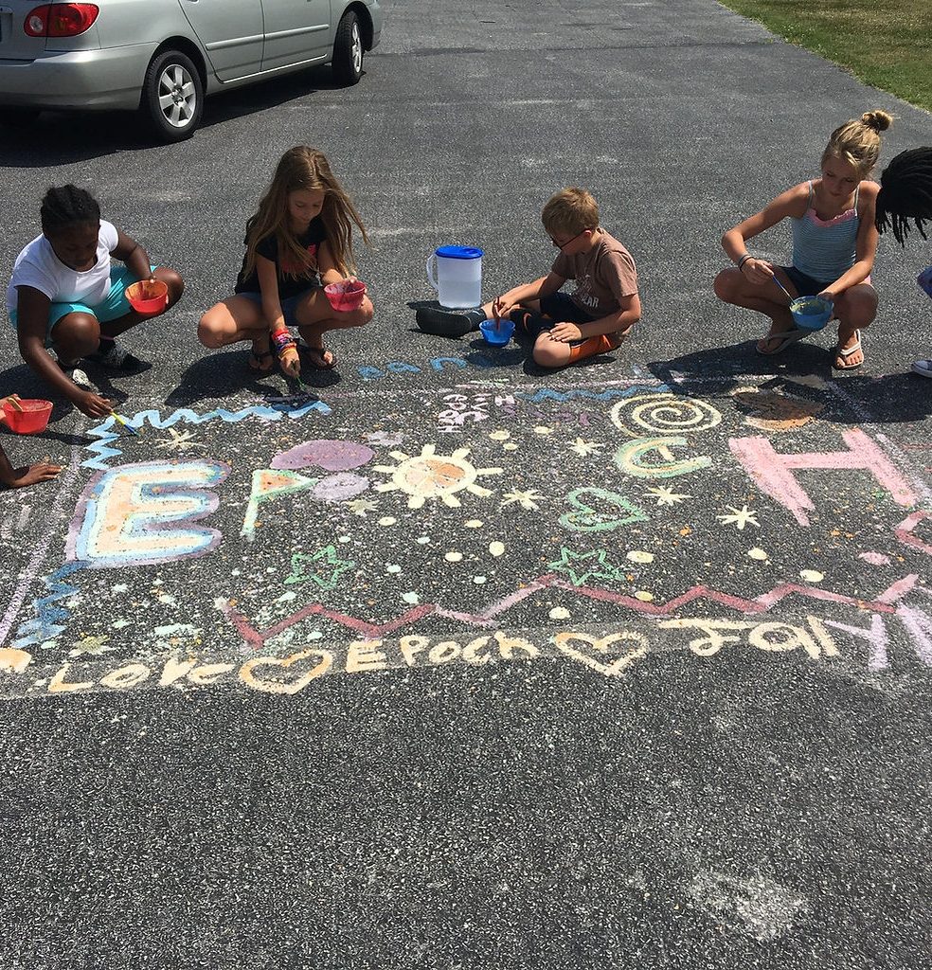
Getting Involved at Epoch
Volunteers
  Assist a class for the afternoon with reading, homework, and game time
Mentors
  Mentors meet with their mentee for one hour per week for at least one year
  Try to get the students matched with mentors
    Can be college students or adults in the community who participate and meet with the students
  Epoch has a therapeutic mentor
Full time school lesion
  Lead teacher who goes into the schools and meets with the teachers
  Epoch has access to academic records
  Teachers attend to after school programs, events, and even family funerals

Slide 8

Epoch Today- Operations
Epoch is on Nanticoke Road in Salisbury, MD 21801
  Cross pointe church of Nazarene- facility might not be as big as they want
    Limited space
    Want to develop new facility in Hebron where they used to be
    To focus on Western Wicomico County
Everyday
  Students get homework help and tutoring
  Students are in a safe place to play and find a mentor
Work in operational manner to always better the students
  Make students feel at home and welcome
  Teach the students life aspects while letting them be a child as well
Continuing to strive for success with great mentors and facility members
Promote other things like the summer programs during the school year this way no customers are lost, and many keep retention and come back

Slide 9

Statistical Reasoning Showing Success
2021
56 students attended Epoch
2021
49 volunteers served more than 3,495 hours
With a volunteer impact of 99,747.30
2021
Students and families were served more then 11,208 meals
2021
Students participated in collectively in more then 10,992 hours of academic tutoring
2022
63 students attended Epoch
2022
45 volunteers served 3,328 volunteer hours
Volunteer impact of 99,673.60
2022
Students and families were served more then 14,976 meals
2022
Students participated in collectively in more then 11,760 hours of academic tutoring

Slide 10

Epoch's Future Marketing
Marketing strategy could grow within this change of developing a new facility for the reasons of
  More community partners
  Will advertise their new facility more, and will promote their organization more often to grab new involvers
    Epoch will segment their advertising more
    More efficient ways:
        FB, LinkedIn, Email, Insta, Tik Tok etc.
  Will have a wider variety of retuning members and students
  Will have better results to advertise their nonprofit to grab people to want to get involved
  Stay consistent with audience and always try and grab more family's attention to get them involved
Continuing these efficiencies will help the nonprofit in the future

Slide 11

Epoch's Future- Operations
The facility could be bigger and possible new locations around the area could be formed
  Larger rooms open possibilities for new activities and more children
Could work to provide more homework time each day
  An hour and a half, to teach them attention span
    By doing this it can show the kids the importance of getting work done on time
    Help with difficult topics and challenging assignments
Since we want Epoch to grow, we have to keep in mind the faculty staff, Hiring is a big part of it
  Hiring new people could lead to more after school ideas to keep student interested and distracted.
  Also having enough workers to keep Epoch open all night long for the kids who may have no were to stay
Continue summer programs to help those kids who need somewhere to go, and for families coming back during school seasons

Slide 12
Impactful Moments Epoch Brings to Students
Many students stay through 12th grade and on to show the impact Epoch has made on students
Epoch guides by 4 principles:
Work hard
Respect authority
Love everyone
Forgive quickly
Students build connections that go past the doors of Epoch
Families are able to trust and know where there child is after school

